Slide 1



APACHE SPARK DEEP DIVE Spark – Real Time Fraud Detection

Slide 2
Real Time Fraud Detection
Today, we are going to discuss building a real time solution for credit card fraud detection.
There are 2 phases to Real Time Fraud detection:
The first phase involves analysis and forensics on historical data to build the ML model.
The second phase uses the model in production to make predictions on live events.

Slide 3
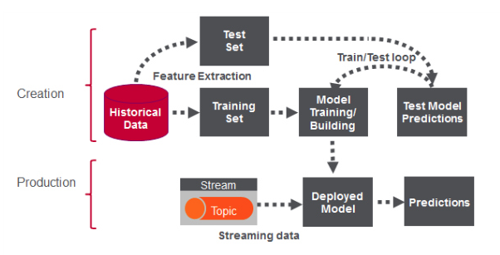

Real Time Fraud Detection

Slide 4
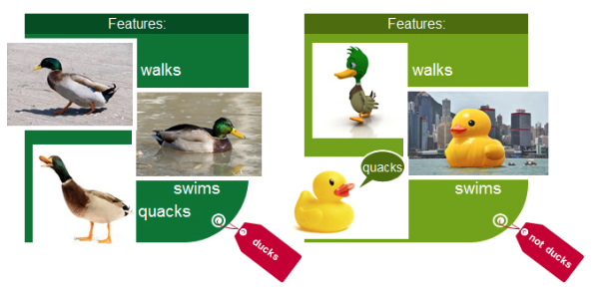

Real Time Fraud Detection : Building the Model
Classification : is a family of supervised machine learning algorithms that identify which category an item belongs to (for example whether a transaction is fraud or not fraud),
Based on labeled examples of known items (for example transactions known to be fraud or not).
Classification takes a set of data with known labels and pre-determined features and learns how to label new records based on that information.
Features are the “if questions” that you ask. The label is the answer to those questions. In the example below, if it walks, swims, and quacks like a duck, then the label is "duck".

Slide 5

Real Time Fraud Detection
Let’s try to understand the process through the Car Insurance Fraud:
What are we trying to predict?
This is the Label: The Amount of Fraud
What are the “if questions” or properties that you can use to predict ?
These are called the Features.
To build a classifier model - we extract the features or attributes of interest that most contribute to the classification.
In this simple example we will use the claimed amount.

Slide 6
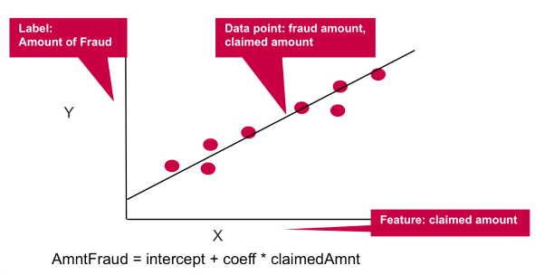
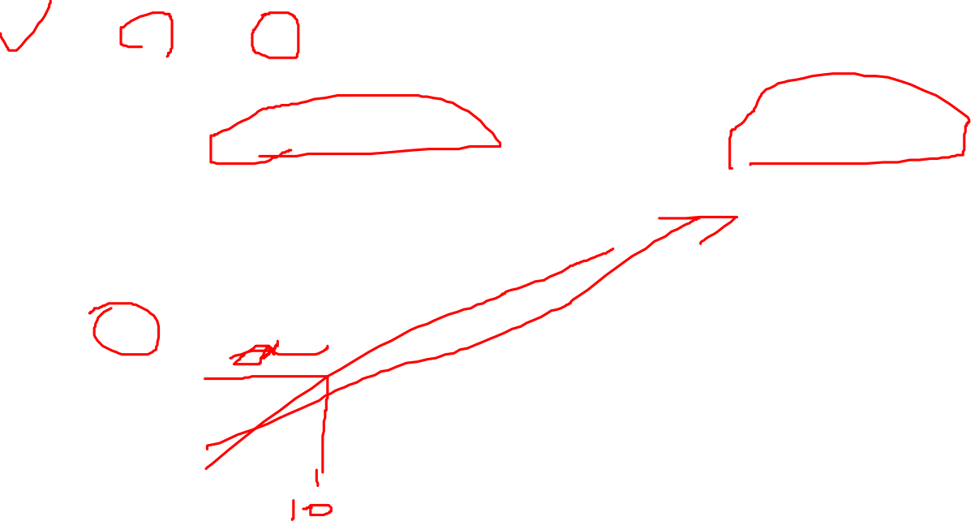
Y = mx + c
Y = Label : Amount Of Fraud , X = Feature : Claimed Amount
Linear regression models the relationship between the Y “Label” and the X “Feature”, in this case the relationship between the amount of fraud and the claimed amount.
The coefficient measures the impact of the feature, the claimed amount, on the label, the fraud amount.

Slide 7
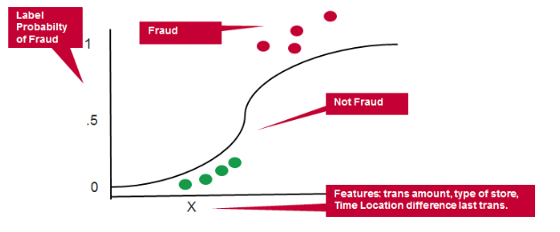

Real Time Fraud Detection
Let’s come back to our credit card fraud as another example:
Example Features: transaction amount, type of merchant, distance from and time since last transaction .
Example Label: Probability of Fraud

Slide 8
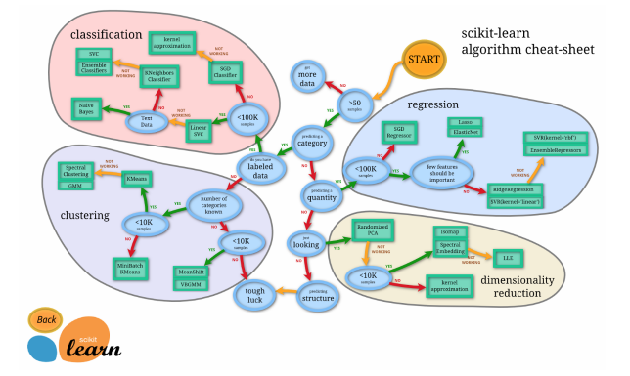

Real Time Fraud Detection
There are three things here now :
Classification: identifies which category (eg fraud or not fraud)
Linear Regression: predicts a value (eg amount of fraud)
Logistic Regression: predicts a probability (eg probability of fraud)
Here is the cheat sheet:

Slide 9

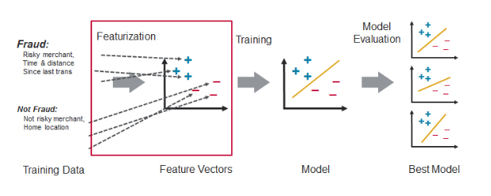
Real Time Fraud Detection : Feature Engineering
Feature engineering is the process of transforming raw data into inputs for a machine learning algorithm.
Feature engineering is extremely dependent on the type of use case and potential data sources.

Slide 10

Real Time Fraud Detection
Looking more in depth at the credit card fraud example for feature engineering, our goal is to distinguish normal card usage from fraudulent card usage.
Goal: we are looking for someone using the card other than the cardholder
Strategy: we want to design features to measure the differences between recent and historical activities.
For a credit card transaction we have
features associated with the transaction,
features associated with the card holder, and
features derived from transaction history.

Slide 11
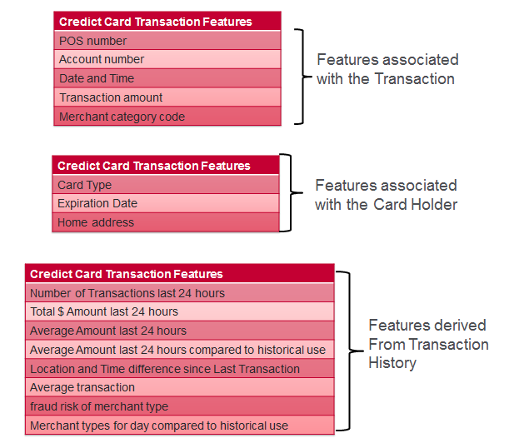

Real Time Fraud Detection

Slide 12

Real Time Fraud Detection : Model Building Workflow
A typical supervised machine learning workflow has the following steps:
Feature engineering to transform historical data into feature and label inputs for a machine learning algorithm.
Split the data into two parts, one for building the model and one for testing the model.
Build the model with the training features and labels
Test the model with the test features to get predictions. Compare the test predictions to the test labels.
Loop until satisfied with the model accuracy:
Adjust the model fitting parameters, and repeat tests.
Adjust the features and/or machine learning algorithm and repeat tests.

Slide 13
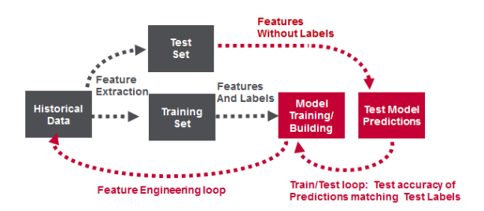

Real Time Fraud Detection

Slide 14
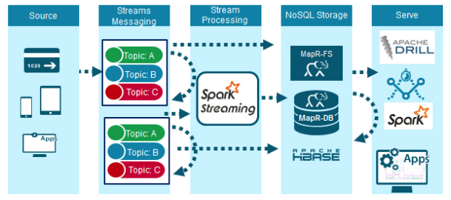

Real Time Fraud Detection Solution
The figure above shows the high level architecture of a real time fraud detection solution, which is capable of high performance at scale.
Credit card transaction events are delivered through some Event Store messaging system i.e Kafka.
The events are processed and checked for Fraud by Spark Streaming using Spark Machine Learning with the deployed model.
HDFS is used for storing all the events data.
NoSql database i.e HBase or MongoDB, is used for storing and providing fast access to credit card holder profile data.

Slide 15
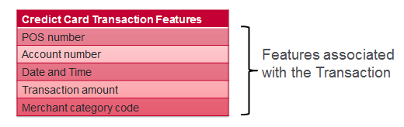

The data flow for the real time fraud detection using Spark Streaming is as follows:
Raw events come into Spark Streaming as DStreams, which internally is a sequence of RDDs.
RDDs are like a Java Collection, except that the data elements contained in RDDs are partitioned across a cluster.
RDD operations are performed in parallel on the data cached in memory, making the iterative algorithms often used in machine learning much faster for processing lots of data.
The credit card transaction data is parsed to get the features associated with the transaction.

Slide 16
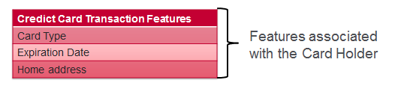
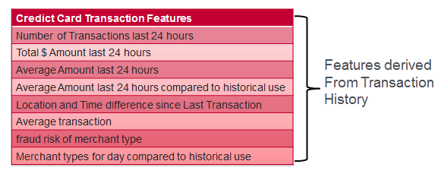
Real Time Fraud Detection
Card holder features and profile history are read from HBase Database using the account number as the row key.
Some derived features are re-calculated with the latest transaction data.

Slide 17

Real Time Fraud Detection
5) Features are run with the model algorithm to produce fraud prediction scores.
6) Non fraud events enriched with derived features are published to the enriched topic.
7) Fraud events with derived features are published to the fraud topic.

Slide 18
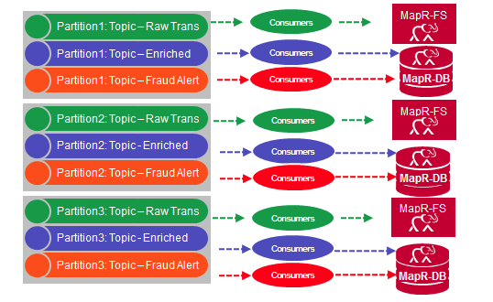

Real Time Fraud Detection
Storage of Credit Card Events :
Messages are not deleted from Topics when read, and topics can have multiple different consumers,
this allows processing of the same messages by different consumers for different purposes.

Slide 19
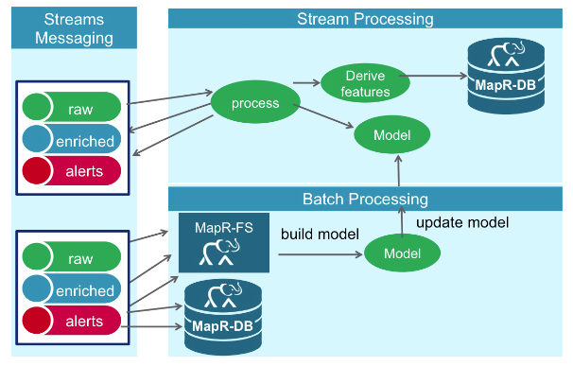

Real Time Fraud Detection
In this solution, Kafka Event Store consumers read and store all raw events, enriched events, and alarms to HDFS for future analysis, model training and updating.
Kafka Event Store consumers read enriched events and Alerts to update the Card holder features in HBASE noSql Database.
Alerts events are also used to update Dashboards in real time.

Slide 20
Real Time Fraud Detection
Summary
Today in this video, we have learned how to build the
Fraud Detection Data Platform that integrates Hadoop and Spark with
real-time database capabilities,
global event streaming, and
scalable enterprise storage.

Slide 21
Real Time Fraud Detection
Thanks and do subscribe to my channel

